Slide 1


CNN-Based Rotation Correction
Advanced Machine Learning
Università degli Studi di Milano-Bicocca
Matteo Breganni 869549

Slide 2
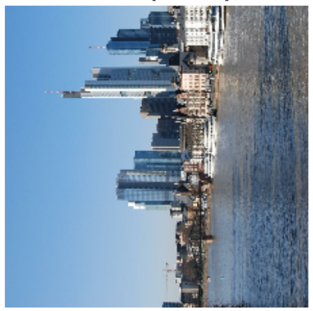
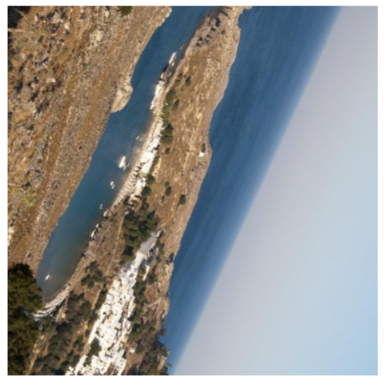
Introduction
Quarter-Turn Rotations
Hand-crafted CNN
Feature extraction
Fine-tuning
Full-Range Rotations
Applying the best method of the first part

Slide 3
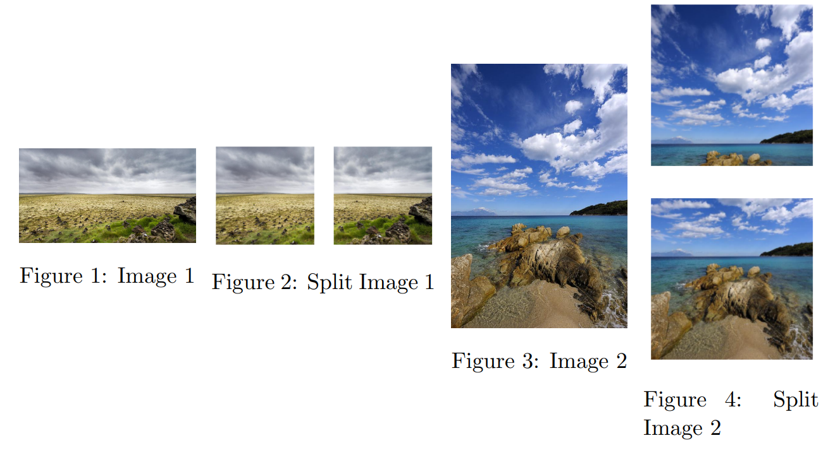
Dataset Preparation
Dataset created by manually sampling from:
Landscape Pictures [1] --> 110 images
Unpaired Day and Night cityview images [2] --> 190 images
60-20-20 Train/Val/Test split
Each image is then divided into one or multiple squares
Dataset becomes only square images, with different resolutions
359 train, 166 val, 117 test.
Random rotations are applied while training, through a data loader
[1] https://www.kaggle.com/datasets/arnaud58/landscape-pictures
[2] https://www.kaggle.com/datasets/heonh0/daynight-cityview

Slide 4
Hand-Crafted CNN Approach

Slide 5
Hand-Crafted CNN Approach
Creating and training a CNN from scratch
Total trainable parameters: 835,716
Data loader that rotates input images randomly (0°, 90°, 180° 270°)
Layer Type | Output Shape | Param #
Input | (224, 224, 3) | /
Conv, 16, 3x3 | (111, 111, 16) | 448
Batch Normalization | (111, 111, 16) | 64
Conv, 32, 3x3 | (55, 55, 32) | 4’640
Batch Normalization | (55, 55, 32) | 128
Conv, 64, 3x3 | (27, 27, 64) | 18’496
Batch Normalization | (27, 27, 64) | 256
Conv, 128, 3x3 + Dropout 40% | (13, 13, 128) | 73’856
Conv, 128, 3x3 + Dropout 50% | (6, 6, 128) | 147’584
Flatten | (4608) | 0
Dense, 128 + Dropout 50% | (128) | 589,952
Output | (4) | 516

Slide 6
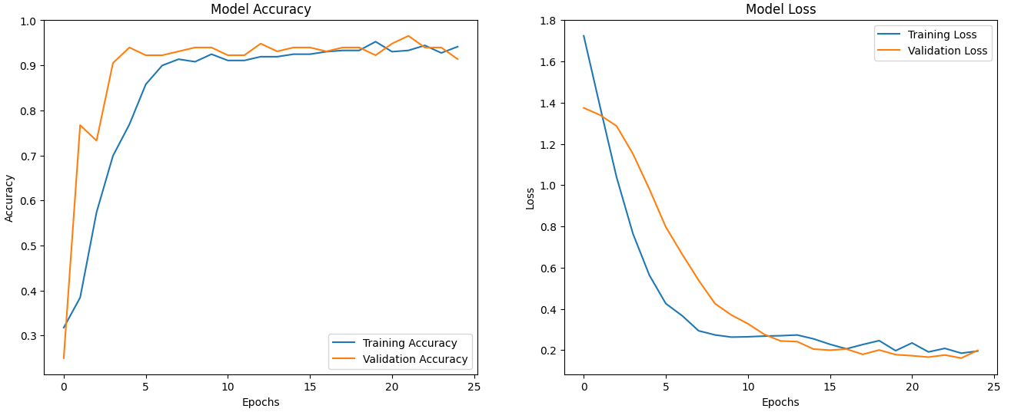
Hand-Crafted CNN: Evaluation
The model converges rapidly

Slide 7
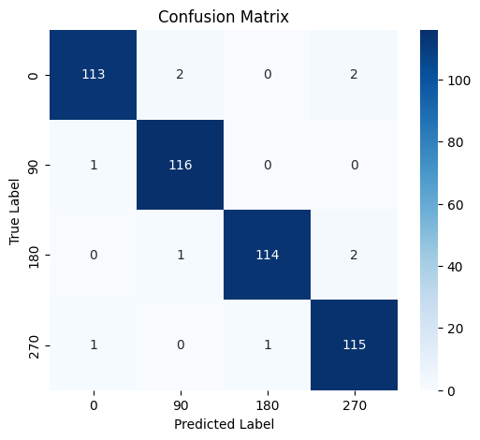
Hand-Crafted CNN: Evaluation
Test set created by rotating the test images by every possible quarter-rotation
Classification report:
Great performance: 98% accuracy
Very few misclassifications, we can retrieve and plot them to further analyze the model
 | Precision | Recall | F1-Score | Support
0 | 0.98 | 0.97 | 0.97 | 117
90 | 0.97 | 0.99 | 0.98 | 117
180 | 0.99 | 0.97 | 0.98 | 117
270 | 0.97 | 0.98 | 0.97 | 117
Accuracy |  |  | 0.98 | 468
Macro avg | 0.98 | 0.98 | 0.98 | 468
Weighted avg | 0.98 | 0.98 | 0.98 | 468

Slide 8
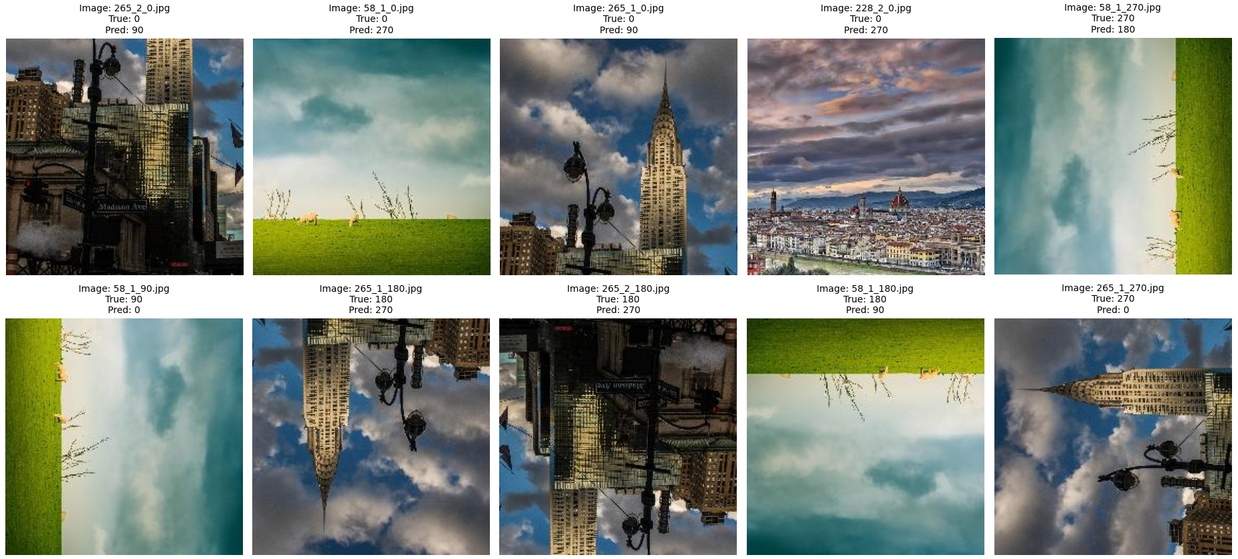
Hand-Crafted CNN: Evaluation
Misclassified images:
Repeated mistakes on the same test images
Indicates a lack of generalization in the model, due to the small dataset’s size

Slide 9
Features Extraction Approach

Slide 10
Feature Extraction Approach
Feature extraction from MobileNetV2
Feature arrays used on a SVM Classifier
Could be a good approach considering the small dataset’s size
Images rotated by every possible rotation (0°, 90°, 180° 270°) to give it the best chance of success (for all train, val and test images)
The function made can be set to fewer unique rotations, by changing a parameter
SVM fitted and hyperparameter optimization done, using the validation set

Slide 11
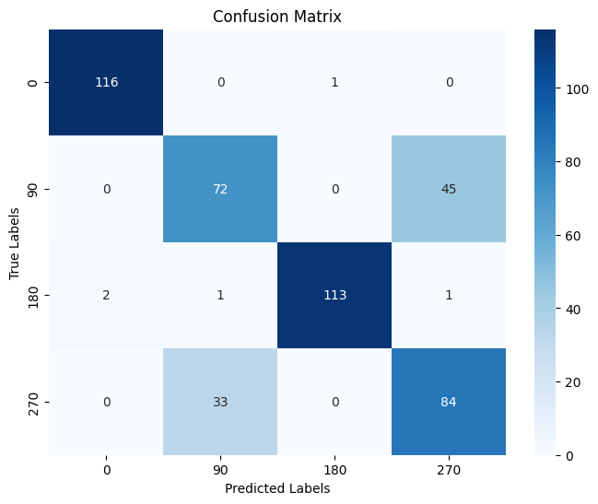
Feature Extraction: Evaluation
Used the best parameters on a new SVM, fitted with both train and validation data, to attempt to increase the performance
The performance increase was very minor
0° and 180°’s performances are comparable to the previous method
90° and 270° are greatly confused with each other
Most likely it’s due to a lack of information about these type of rotations in the extracted features
Class | SVM Best Parameters |  |  | SVM with Added Val Data
 | Precision | Recall | F1-Score | Precision | Recall | F1-Score
0 | 0.98 | 0.98 | 0.98 | 0.98 | 0.99 | 0.99
1 | 0.64 | 0.60 | 0.62 | 0.68 | 0.62 | 0.65
2 | 0.98 | 0.97 | 0.98 | 0.99 | 0.97 | 0.98
3 | 0.63 | 0.68 | 0.65 | 0.65 | 0.72 | 0.68
Accuracy |  |  | 0.81 |  |  | 0.82
Macro Avg | 0.81 | 0.81 | 0.81 | 0.82 | 0.82 | 0.82
Weighted Avg | 0.81 | 0.81 | 0.81 | 0.82 | 0.82 | 0.82

Slide 12
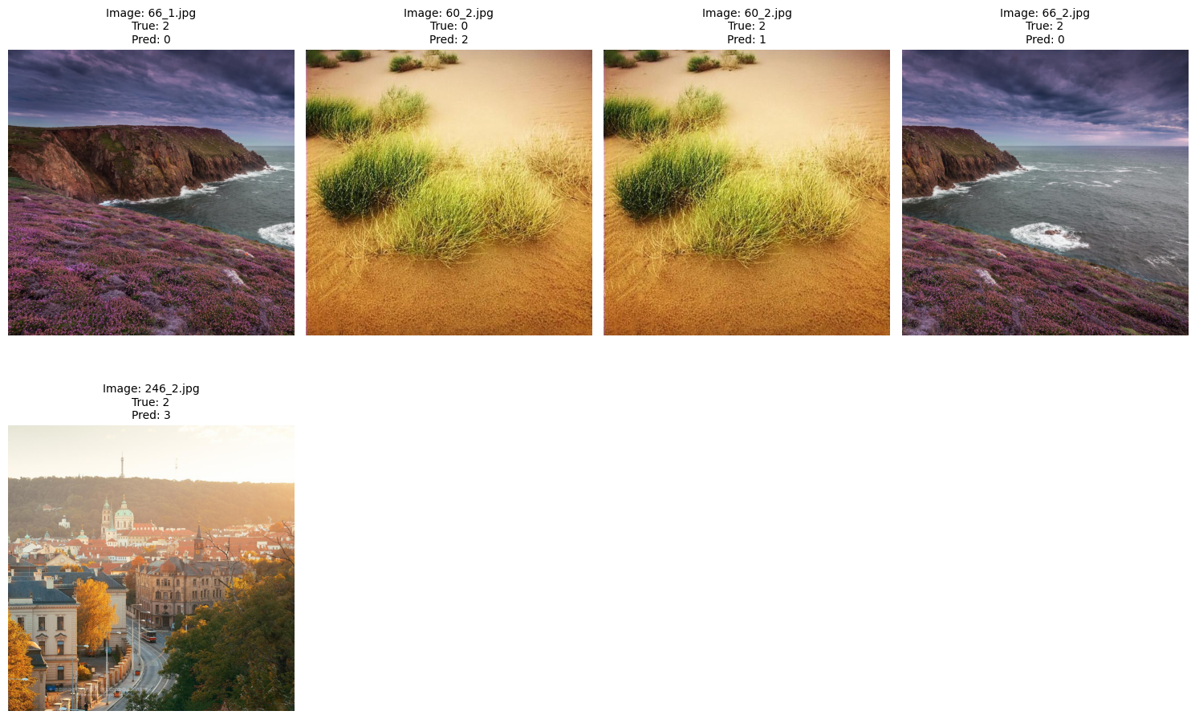
Feature Extraction: Evaluation
Plotting all the mistakes made on 0° and 180° classes:
(images not rotated)
Two images are misclassified for both rotations
Different from the images of the previous method
This cannot be a sure indication of possible better generalization

Slide 13
Fine-Tuning Approach

Slide 14
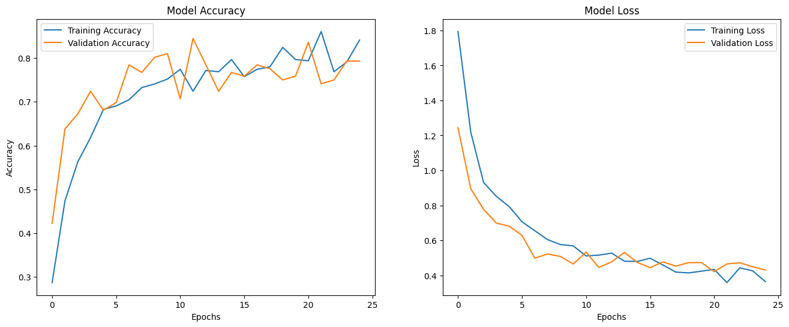
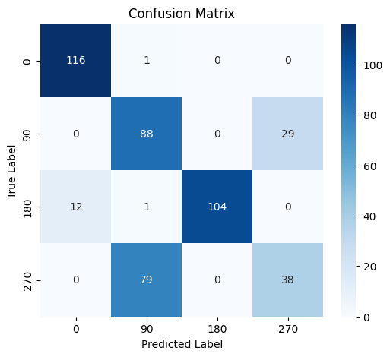
Fine-Tuned CNN: Evaluation
Fine-tuning of MobileNetV2 pre-trained on ImageNet
Freezing the base model’s weights at the start
Adding a dense layer (512) with 0.6 dropout and the output layer
Using MobileNetV2’s preprocessing pipeline to prepare the images
Seems to be suffering from the same issue as the feature extraction method
The issue stands in the pre-trained network
 | Precision | Recall | F1-Score | Support
0 | 0.91 | 0.99 | 0.95 | 117
90 | 0.52 | 0.75 | 0.62 | 117
180 | 1 | 0.89 | 0.94 | 117
270 | 0.57 | 0.32 | 0.41 | 117
Accuracy |  |  | 0.74 | 468
Macro avg | 0.75 | 0.74 | 0.73 | 468
Weighted avg | 0.75 | 0.74 | 0.73 | 468

Slide 15
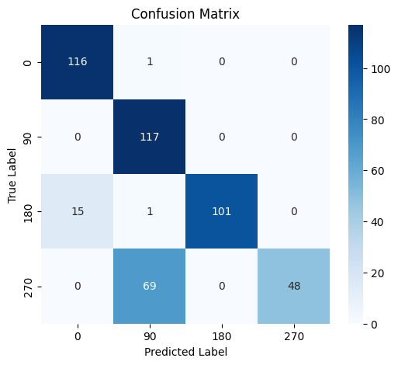
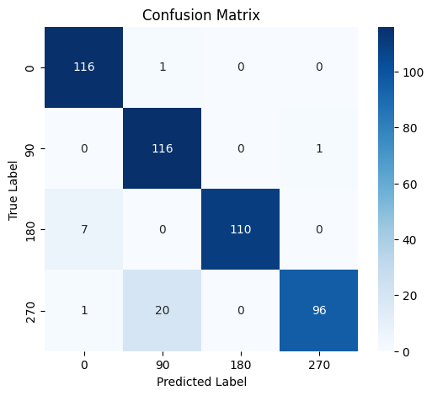
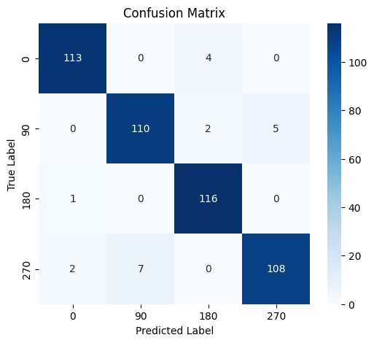
Further Fine-Tuning (unfrozen)
Further fine-tuning un-freezing the base model’s weights, with a lower learning rate
Increasingly more training on the previous model
The issue on the classes 90° and 270° slowly gets «fixed»
Not reaching the hand-crafted performance (could be fine-tuned more though)
The classification task for which MobileNetV2 was trained is not compatible with this task, as it does not capture lateral-rotation information well
Model 2 accuracy: 82% Model 3 accuracy: 94% Model 4 accuracy: 96%

Slide 16
Full Range Rotations

Slide 17
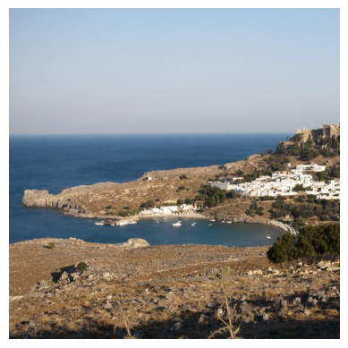
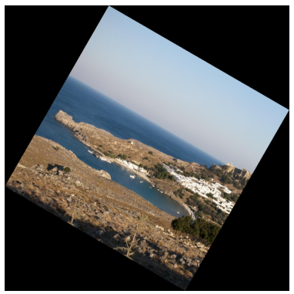
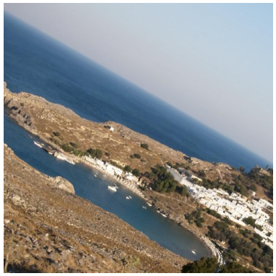
Full Range Rotations
Expanding the previous methods, while applying the best one (hand crafted CNN) to this task
Images can now be rotated any amount from 0° to 360°.
Customs functions were necessary to rotate the images
Black fill must be deleted, otherwise the model would use it to learn
The biggest square that fits inside the rotated image is cropped [2]
[2] https://math.stackexchange.com/questions/828878/calculate-dimensions-of-square-inside-a-rotated-square

Slide 18
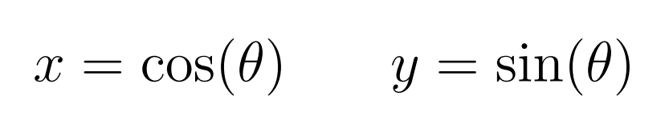
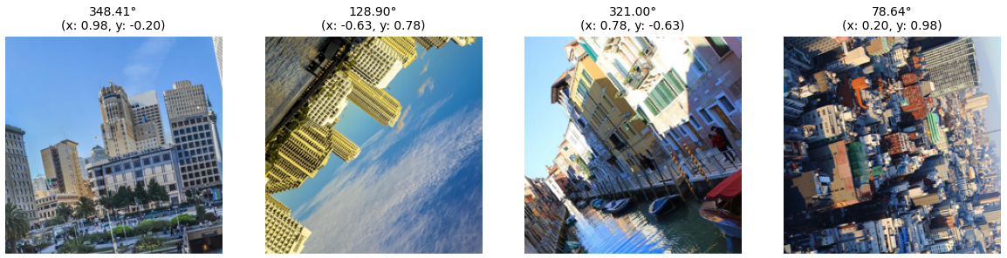
Full Range Rotations
The output cannot be one-hot encoded anymore, but it also shouldn’t be the rotation amount in degrees.
If the rotation amount was used, rotations like 1° and 259° would be seen as polar opposites, not close rotations.
The rotations were converted to two x and y values:
where θ is the rotation angle in radians.

Slide 19
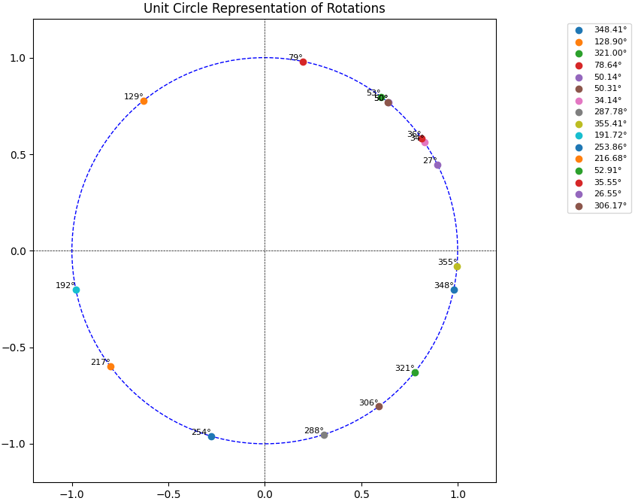
Full Range Rotations
Rotations like 0° and 259° are next to each other
Rotations like 0° and 180° are opposite of each other

Slide 20
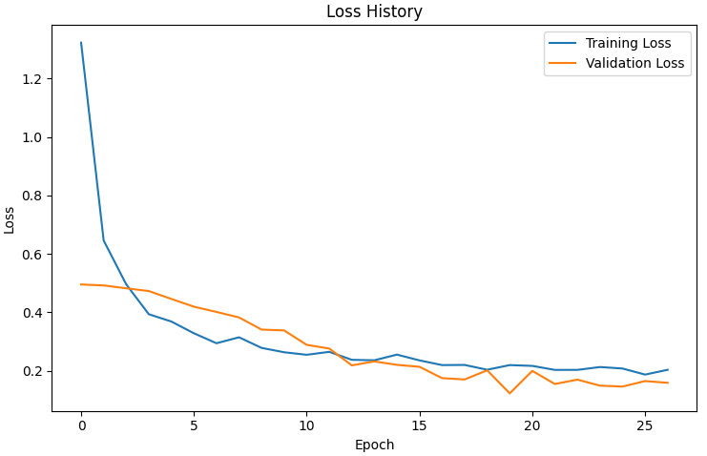
Full Range Rotations: Evaluation
The same hand-made model architecture was used
With slightly higher learning rate
Test Loss (mse): 0.15
Average error in degrees: 27.08°
Fairly acceptable considering that the images in the dataset are not necessarely perfectly level. A more curated dataset could improve the performance.
The model’s architecture could be improved, for example with a bigger dense layer before the output, 128 neurons might be too little

Slide 21
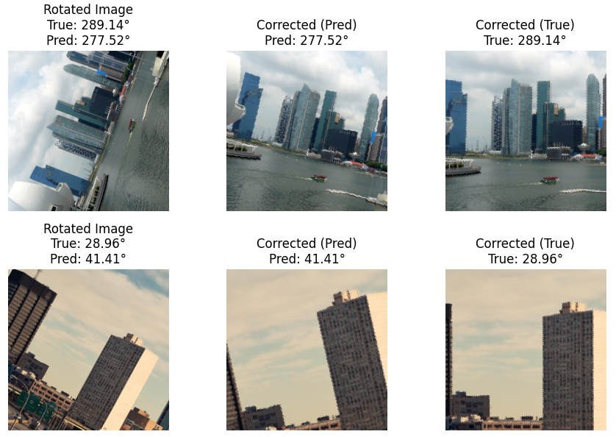
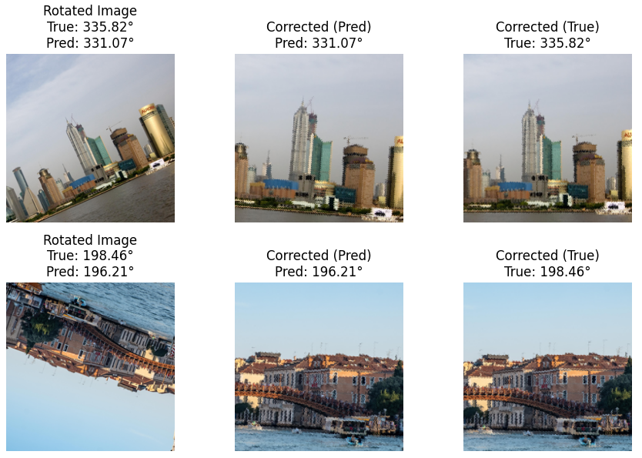
Full Range Rotations: Evaluation
To better evaluate the results, let’s correct the rotations:
Small rotation errors are very noticeable to the human eye

Slide 22
Thanks for your attention

Slide 23
Thanks for your attention
CNN-Based Rotation Correction
Advanced Machine Learning
Università degli Studi di Milano-Bicocca
Matteo Breganni 869549

